Slide 1
PRDA – 03 HR Analytics
Pavithra S
01/10/26

Slide 2
Agenda
Introduction & Objectives
Dataset Overview
Key KPIs
Visualizations
Insights & Trends
Recommendations
Conclusion & Q&A

Slide 3
Data Set Overview
Our HR dataset contains records of approximately 22,214 employees spanning from 2000 to 2020. It captures demographic details, organizational structure, and employment history, giving us a comprehensive view of the workforce.
Demographics: Age, Gender, Race
Organization: Department, Job Title, Location [HQ vs Remote, State, City ]
Employment : Hire Date, Term Date
Purpose: To analyze workforce distribution, diversity and hiring trends.

Slide 4
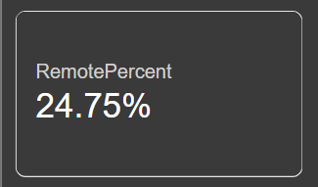
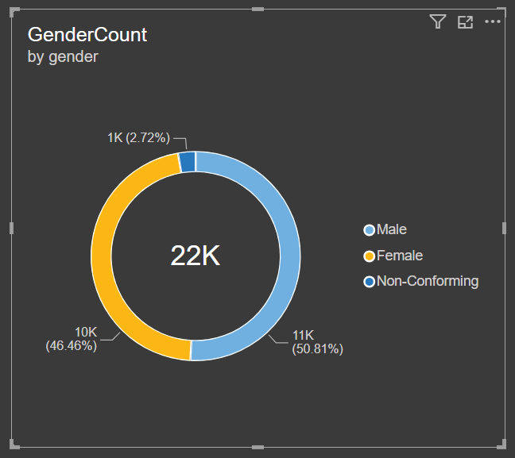
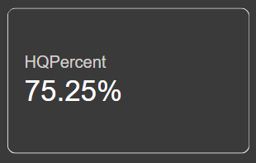
Key Force KPIs
To understand our workforce at a glance, here are the three most important metrics that summarize employee distribution and demographics.

Slide 5
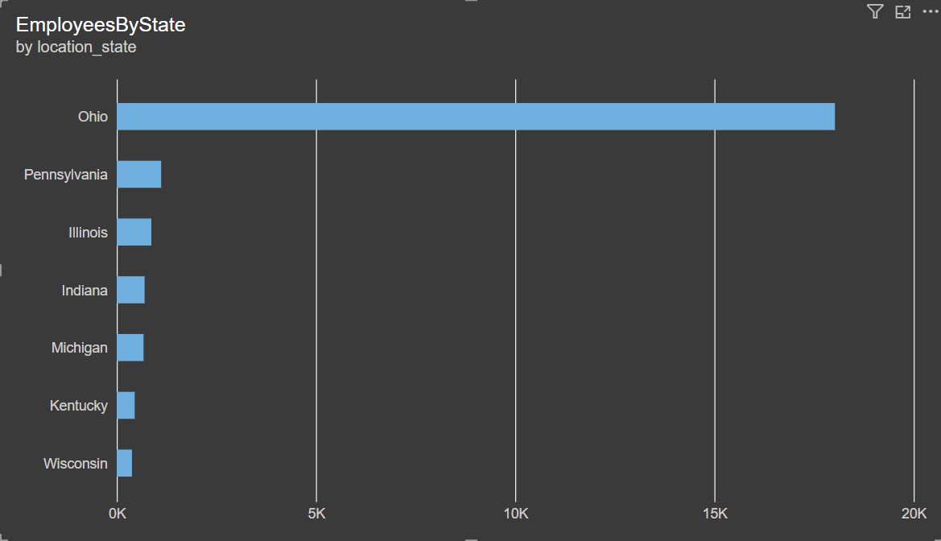
🌍 Employees by State
Ohio has a significantly higher number of employees compared to all other states.
States like Kentucky and Wisconsin have relatively fewer employees.
➡️ The workforce is concentrated in Ohio, indicating it may be the company’s primary hub or headquarters

Slide 6
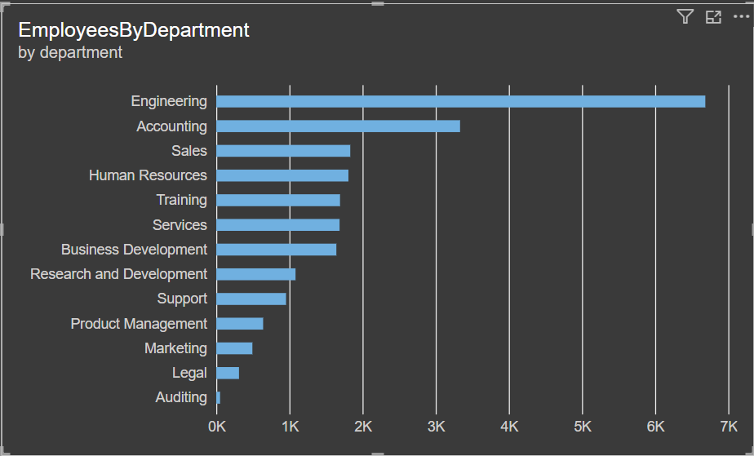
📊 Employees by Department
Engineering has the largest workforce, standing out as the dominant department.
Accounting follows as the second largest.
Departments like Auditing and Legal have the smallest employee counts.
➡️ This suggests the company is heavily tech-focused, with support functions being leaner.

Slide 7
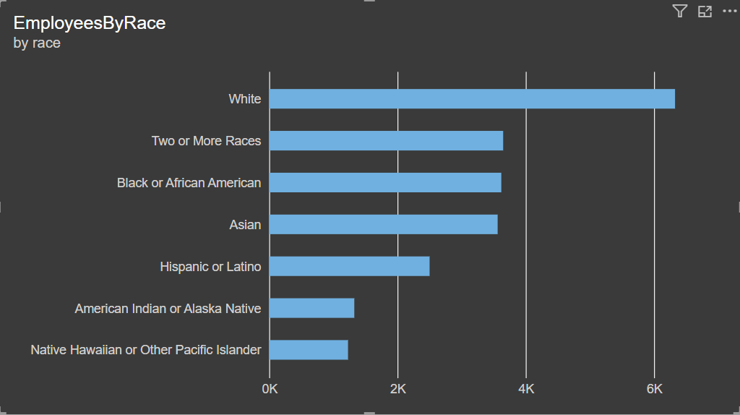
🧑‍🤝‍🧑 Employees by Race
The majority of employees identify as White.
Other groups such as Black or African American, Asian, and Hispanic or Latino are present but in smaller proportions.
Native Hawaiian or Other Pacific Islander has the lowest representation.
➡️ Diversity exists but is uneven, with one group dominating the workforce composition.

Slide 8
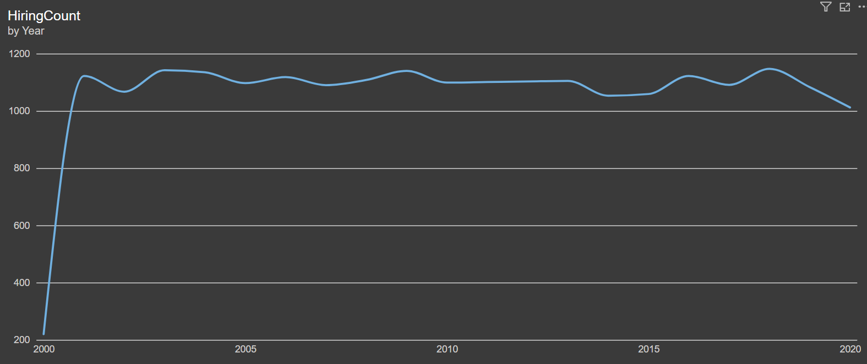
Hiring Trends (2000–2020)
“Hiring peaked in 2005 and 2015, but declined steadily after 2015, indicating a shift in workforce strategy.”

Slide 9
Hiring Trend Summary
2000 - 2001: Sharp increase in hiring, marking a strong growth phase.
2002- 2005: Several Peaks, with a notable high around 2005.
2006- 2010: Fluctuations with moderate hiring activity.
2011- 2015: Another surge, peaking around 2015.
2015-2022: Gradual Decline in hiring, showing reduced recruitment activity in recent years.
“Attrition stands at ~18%, which is above industry norms. With hiring declining after 2015, the workforce is contracting. Retention strategies are critical to stabilize headcount.”

Slide 10
Analysis of your HR dataset across multiple features
Workforce Size &Distribution
* Total Employees were 22,214 based on the dataset
* Location Split: Majority[~75.25%] are based at Headquarters (Cleveland, Ohio),while [~24.75%] are Remote across various U S.States.
* Preference: Employees are spread across Ohio, Pennsylvania, Michigan, Kentucky, Indiana etc, showing a mix of concentration and remote diversity.

Slide 11
Demographics
Gender: Predominantly Male and Female, with a small representation of Non-Conforming employees.
Race: Diverse workforce including White, Black or African American, Asian, and Two or More Races,
Age: Average is ~38.4 years.
Youngest Employees: ~20-22years.
Oldest Employees:~ 57 years.
Most Employees fall in the 25-45 age range, indicating a mid-career workforce

Slide 12
Departmental Insights
Largest Departments: Engineering, Business Development, Services, and Training.
Smaller Departments: Legal, Auditing, Marketing, and Research & Development.
Engineering stand out as the backbone, employing a wide range of roles (Developers, Programmers, Analysts, System Admins)

Slide 13
Insights Derived
Workforce Concentration: ~75.25% of employees are based in Cleveland HQ, while ~24.75% are remote. Remote hiring has increased steadily since 2010, showing flexibility in workforce strategy.
Age Profile: Average age is ~38.43 years. Most employees are between 25–45 years, balancing fresh talent with experienced professionals.
Gender Diversity: Workforce is predominantly Male/Female, with representation of Non‑Conforming employees. Gender diversity initiatives could be strengthened in technical departments.
Racial Diversity: Strong representation across White, Black or African American, Asian, Hispanic/Latino, Native Hawaiian/Pacific Islander, American Indian/Alaska Native, and Two or More Races. Engineering leans more towards White/Asian, while Business Development and Services show broader diversity
Departmental Strength: Engineering is the largest department, followed by Business Development and Training. Smaller but critical functions like Legal, Auditing, and Marketing exist but have fewer employees.
Hiring Trends: Hiring peaked in the early 2000s (HQ‑centric) and shifted towards remote roles post‑2010, aligning with modern workforce practices.

Slide 14
Suggestions/Recommendations
Expand Remote Strategy: Since remote hiring is increasing, invest in stronger remote collaboration tools and policies to maintain productivity and engagement.
Enhance Diversity Programs: While racial diversity is strong, gender diversity in technical roles (Engineering, IT) could be improved through targeted recruitment and mentorship.
Succession Planning: With a significant portion of employees in the 40–55 age range, prepare leadership pipelines and knowledge transfer programs to avoid skill gaps.
Departmental Balance: Engineering dominates headcount. Consider strengthening smaller departments (Legal, Auditing, Marketing) to support growth and compliance.
Retention Focus: Analyze term dates to identify attrition patterns. Tailored retention strategies (career growth, training, flexible work) can reduce turnover.

Slide 15
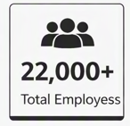
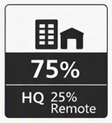
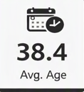
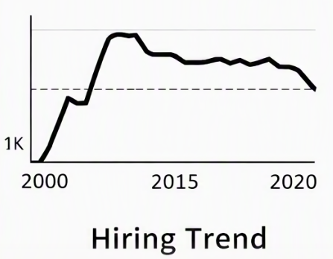
Executive Summary
Analysis of workforce metrics and trends from the dataset
KEY FINDINGS
Total Employees: 22,214 records analysed
18% Attrition observed [4,000 terminated]
HQ: 75% Cleveland, 25% Remote.
Avg. Age: 38.4 years
Implication
High attrition highlights retention challenges.
Ohio HQ with growing remote workforce.
Diverse employee demographics
Recommendations
Investigate attrition root causes and address.
Enhance engagement for remote staff
Promote diversity and inclusion initiatives.
Hiring Peaked in early 2000s, stabilized around 1k hires/year, declined after 2015.
> Closing Note: Insights from this analysis provide a foundation for strategic workforce planning and informed HR decision‑making.

